Slide 1
Microsoft Power Platform - Hackathon

Slide 2
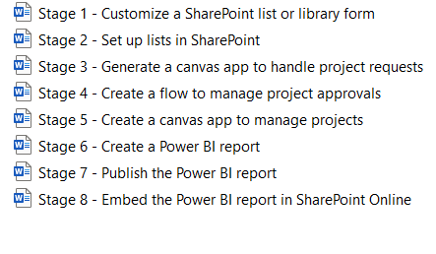
Use Cases
The company Contoso has a SharePoint Online site where they manage the lifecycle of projects, from request, to approval, to development, to final review.
A project requestor, such as a department head, requests an IT project by adding an item to a SharePoint list.
A project approver, such as an IT manager, reviews the project, and then approves it or rejects it.
If approved, the project is assigned to a project manager, and additional detail is added to a second list through the same app.
A business analyst reviews current and completed projects using a Power BI report embedded in SharePoint.
Power Automate is used to send approval email and respond to Power BI alerts.

Slide 3
Submittion
Send the Screenshot as PPT To Jenkinsns@jpower4.com

